Slide 1

Predicting Sales for IronKaggle Project
By Kerem Senler, Caroline Araujo

Slide 2
Agenda
Objective
Workflow Overview
Testing the models
Results and Expected Performance

Slide 3
Part 1: Objective
Goal: Predict sales for given shop data using machine learning models.
Dataset: Provided training set includes sales and various features for each shop per day.
Task: Develop a model to predict sales for the real-life dataset that lacks sales information.

Slide 4
Part 2: Workflow
Step 6: Results and Expected Performance
Step 2: Future Engineering
Step 4: Model Evaluation
Step 1: EDA
Data Loading and Exploration
Data Preprocessing and Cleaning
Step 3: Model Selection and Training
Step 5: Real-Life Data Prediction

Slide 5
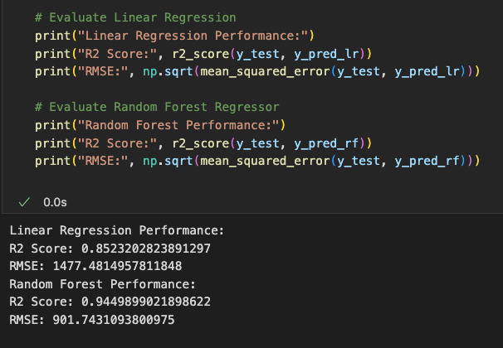

Part 3: Testing Models
Linear Regression
Performance Check
 | Linear Regression | Random Forest
R2 Score | 0.82 | 0.99
RMSE | 1477 | 322
Time to Run | 6 min. | 8 min.
Random Forest

Slide 6
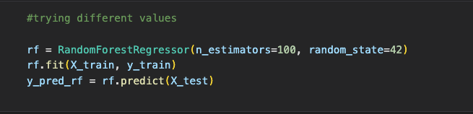
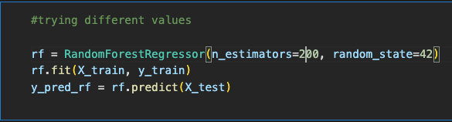
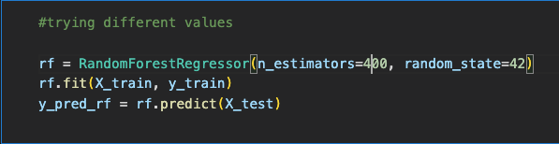
Part 3: Testing Random Forest to improve
The chosen one
Number of estimators | 100
R2 score | 0.9929
RMSE | 322.372
Minutes to run | 8 minutes
Number of estimators | 200
R2 score | 0.9942
RMSE | 321.488
Minutes to run | 15 minutes
Number of estimators | 400
R2 score | 0.9947
RMSE | 321.256
Minutes to run | 25 minutes

Slide 7
Part 4: How
Step 4: Create another RandomForest model to get the new R2 and RMSE values with new data
Step 1: Create Randomforest Model
Step 2: Run the model to predict the sales number
Step 3: Create a csv file with a new column called predicted_sales

Slide 8
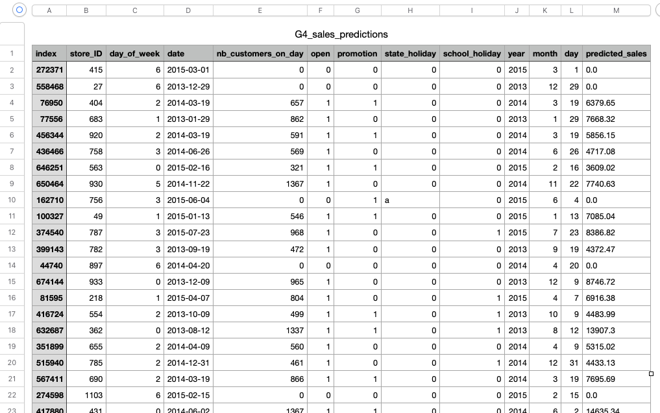
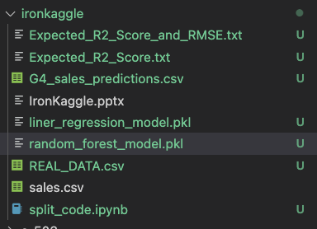
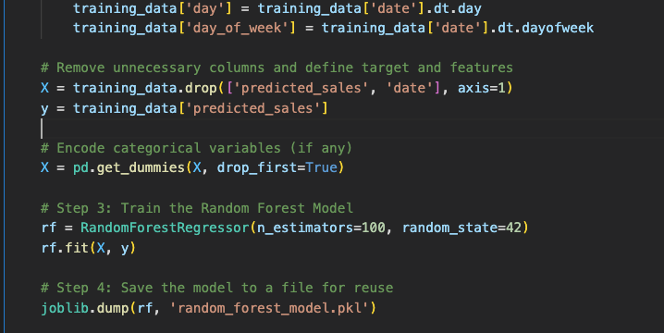
Part 4: Results and expected performance
Project Files
G3_sales_predicted
Training the model with predicted results to calculate the R2 and RMSE values for G3_Sales_predicted
Better results than sales.csv trained model

